Slide 1
AHB to APB BRIDGE VERIFICATION
Presentation by A M BASAVAKIRAN

Slide 2
INTODUCTION AND AIM
This project deals with the class based verification of bridge between high speed AMBA AHB(Advanced High Performance bus) and low-power AMBA APB (Advanced Peripheral Bus) in UVM.
The AMBA AHB is for high-performance, high clock frequency system modules.
The AMBA APB is for low-power peripherals.

Slide 3
FUNCTIONS OF BRIDGE
Latches the address and holds it valid throughout the transfer.
Decodes the address and generates a peripheral select, PSELx.
Only one select signal can be active during a transfer.
Drives the data onto the APB for a write transfer.
Drives the APB data onto the system bus for a read transfer.
Generates a timing strobe, PENABLE, for the transfer.

Slide 4
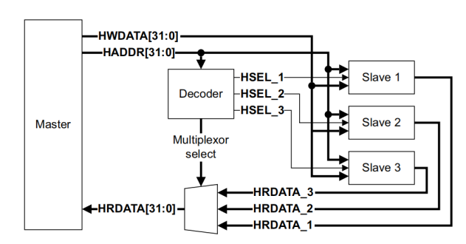
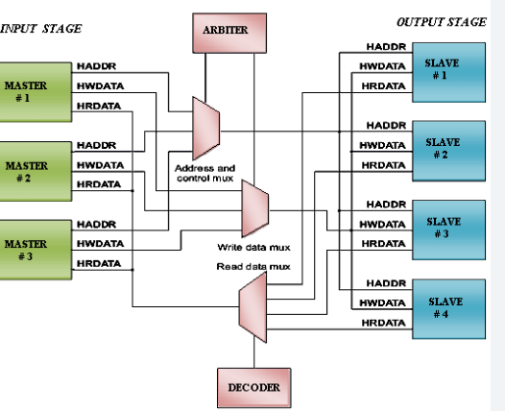
AHB BLOCK DIAGRAM

Slide 5
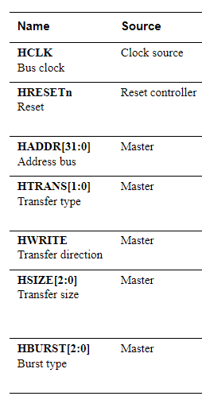
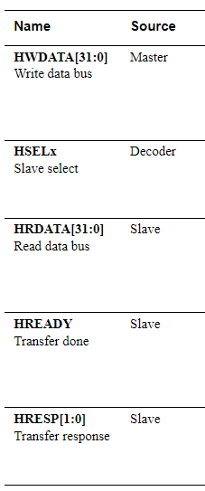
AHB PROTOCOL SIGNALS

Slide 6
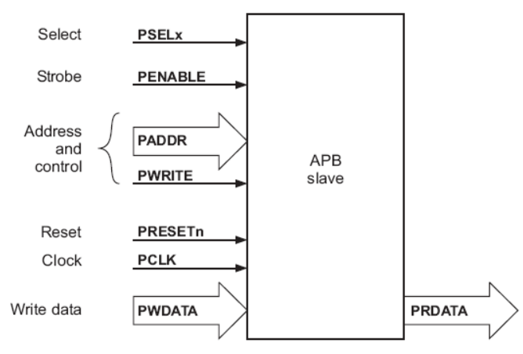
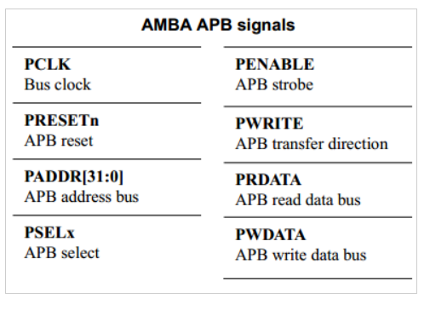
APB BLOCK DIAGRAM AND SIGNALS

Slide 7
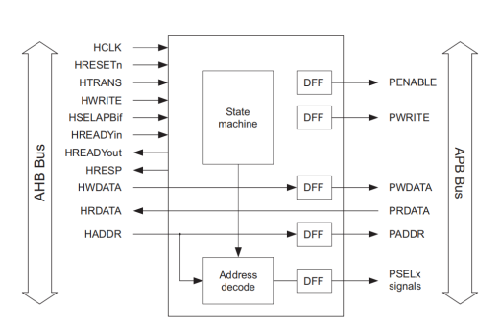
BLOCK DIAGRAM OF BRIDGE

Slide 8
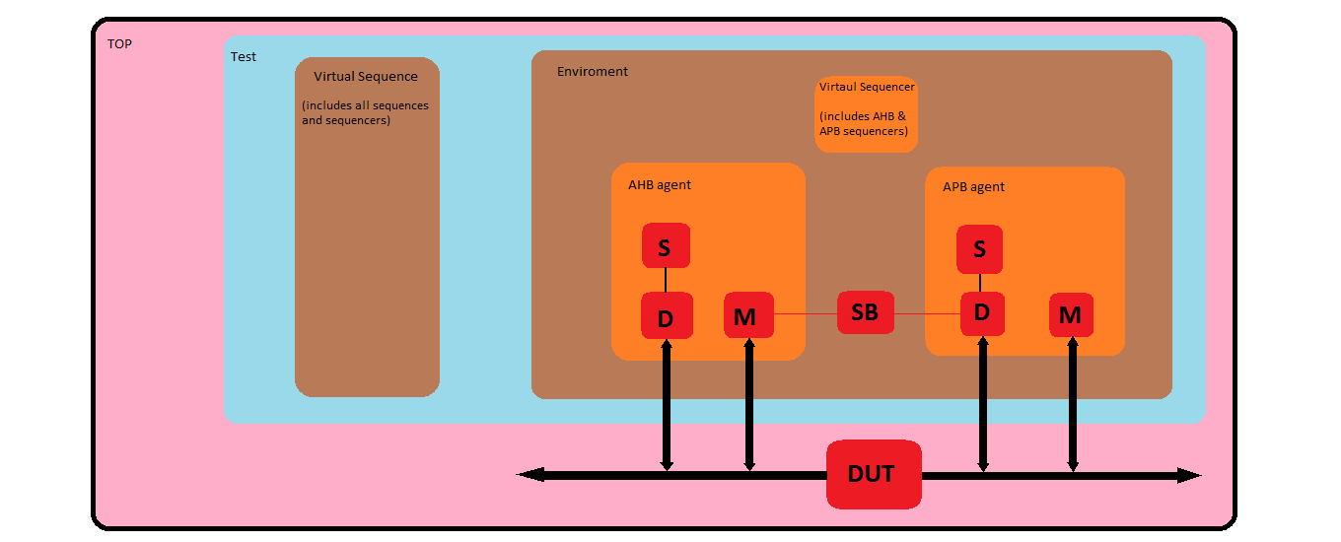
UVM ARCHITECTURE

Slide 9
AHB SEQUENCE ,DRIVER AND MONITOR LOGIC
AHB sequence logic: We write all burst sequences, Based on their size .
AHB driver logic: Wait till Hreadyout is high send control signals along with Haddr in the first clock cycle. In the next clock cycle check if Hreadyout is high and then send Hwdata to DUT.
AHB monitor logic: Wait till Htrans is 2 or 3 and then collect control signals from the interface . In the next clock cycle wait till Hreadyout is high and then collect data signal.Create a copy of collected data and write into the tlm_analysis_fifo using 'write' method.

Slide 10
APB DRIVER AND MONITOR LOGIC
APB driver logic: Wait till Penable is high and then drive randomized Prdata when Pwrite is low.
APB monitor logic: Wait till Penable is high and check for Pwrite . If Pwrite is high then collect Pwdata and Paddr else collect Prdata, Paddr and Hrdata from the DUT. Send these collected items to second tlm_analysis_fifo in the scoreboard using 'write' method.

Slide 11
TESTCASE DETAILS
Single transfer
Unspecified increment
4-beat wrapping burst.
4-beat incrementing burst.
8-beat wrapping burst.
8-beat incrementing burst.
16-beat wrapping burst.
16-beat incrementing burst.

Slide 12
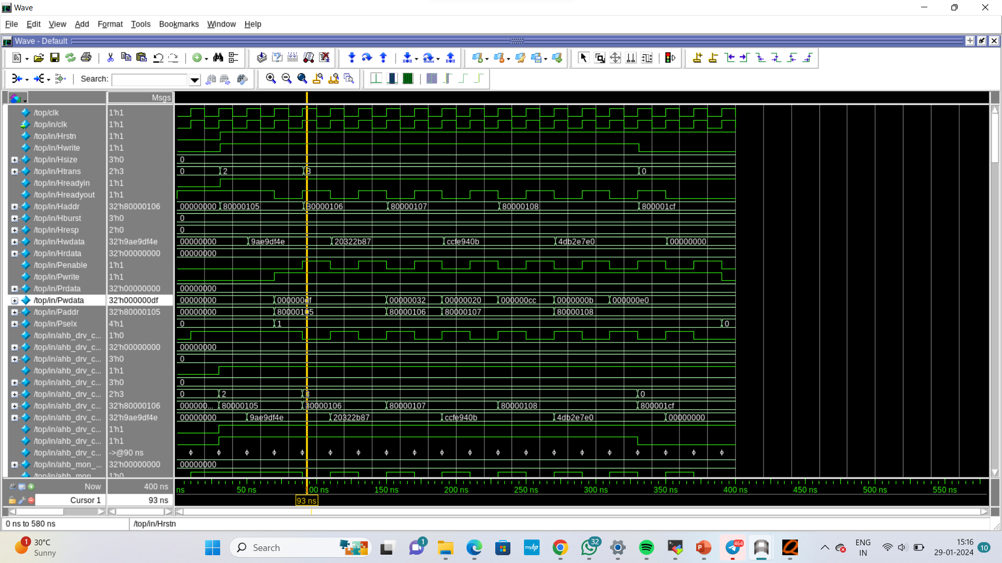
INCREMENT 4 BURST OPERATION

Slide 13
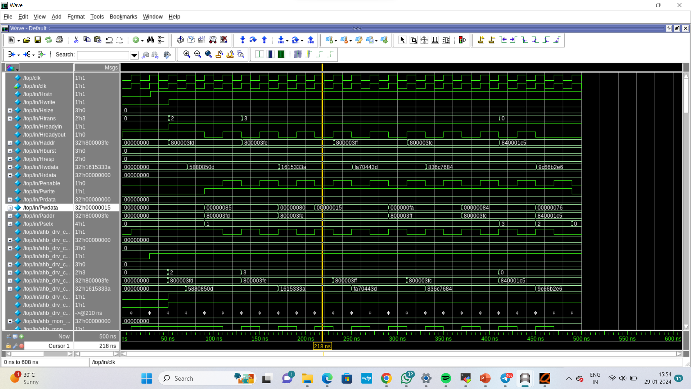
WRAP 4 BURST OPERATION

Slide 14
THANK YOU

